Slide 1

Introduction to CAP Theorem
Ravindu Nirmal Fernando
SLIIT | March 2025
https://ravindunfernando.com

Slide 2
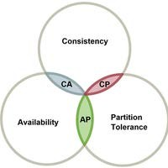
CAP THEOREM
A fundamental theorem in distributed systems.
Can have at most two of the following three properties,
Consistency
Availability
Partition Tolerance

Slide 3
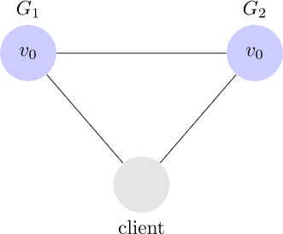
DISTRIBUTED SYSTEM
🞂​ Consider a simple distributed system with two servers, G₁ and G₂
🞂​ The servers can communicate with each other and connect to remote clients
https://mwhittaker.github.io/blog/an_illustrated_proof_of_the_cap_theorem/

Slide 4
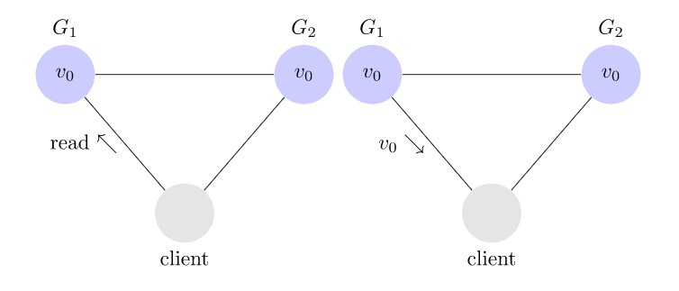
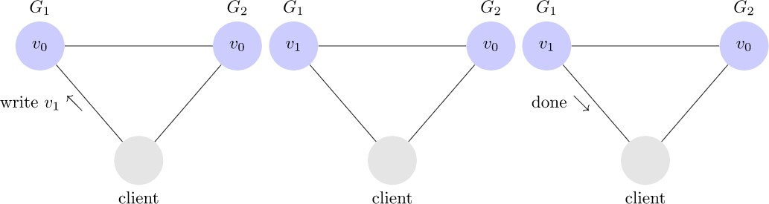
DISTRIBUTED SYSTEM
🞂​ Read example
🞂​ Write example
https://mwhittaker.github.io/blog/an_illustrated_proof_of_the_cap_theorem/

Slide 5
CONSISTENCY
Consistency means that all clients see the same data at the same time, no matter which node they connect to.
For this to happen, whenever data is written to one node, it must be instantly forwarded or replicated to all the other nodes in the system before the write is deemed ‘successful.’

Slide 6
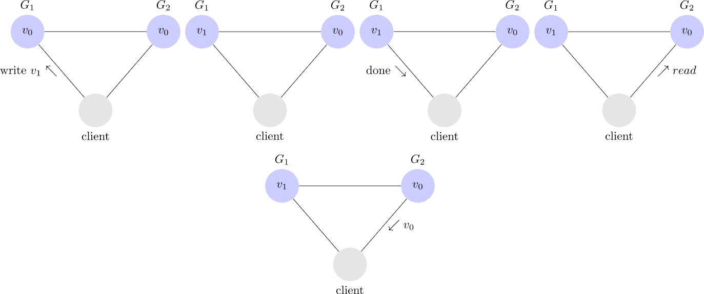
CONSISTENCY
Inconsistent system
https://mwhittaker.github.io/blog/an_illustrated_proof_of_the_cap_theorem/

Slide 7
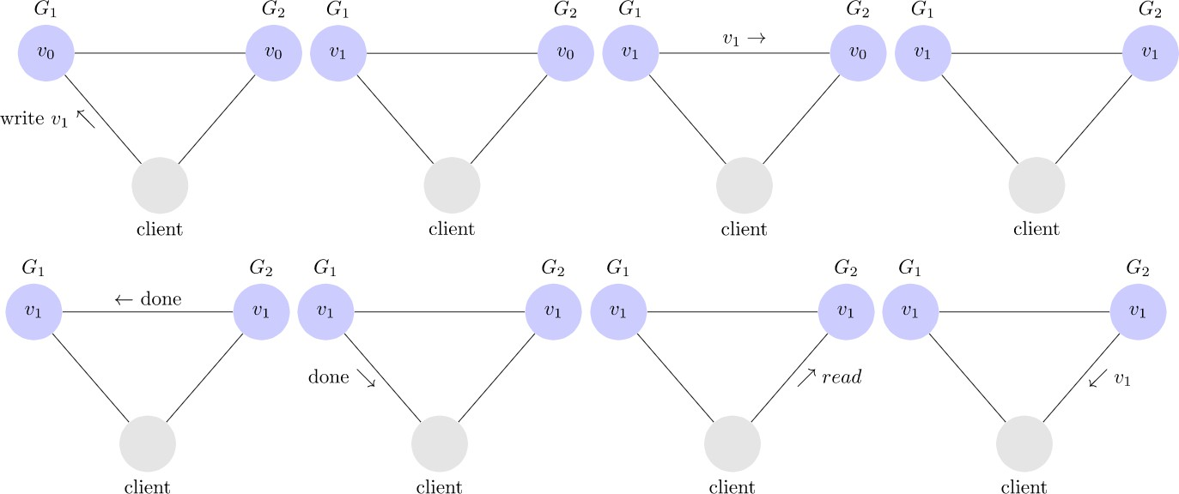
CONSISTENCY
Consistent system
https://mwhittaker.github.io/blog/an_illustrated_proof_of_the_cap_theorem/

Slide 8
AVAILABILTY
Availability means that any client making a request for data gets a response, even if one or more nodes are down.
Another way to state this—all working nodes in the distributed system return a valid response for any request, without exception.

Slide 9
PARTITION TOLERANCE
A partition is a communications break within a distributed system—a lost or temporarily delayed connection between two nodes.
Partition tolerance means that the cluster must continue to work despite any number of communication breakdowns between nodes in the system.

Slide 10
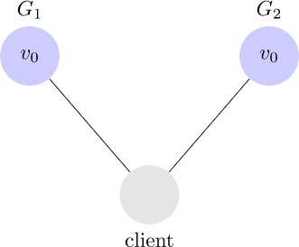
PARTITION TOLERANCE
The system continues to operate despite network partitions
Communication among the servers is not reliable
Servers may be partitioned into multiple groups that cannot communicate with each other
Messages may be delayed or lost forever
https://mwhittaker.github.io/blog/an_illustrated_proof_of_the_cap_theorem/

Slide 11
PROOF
Consider partitioned system,
https://mwhittaker.github.io/blog/an_illustrated_proof_of_the_cap_theorem/

Slide 12
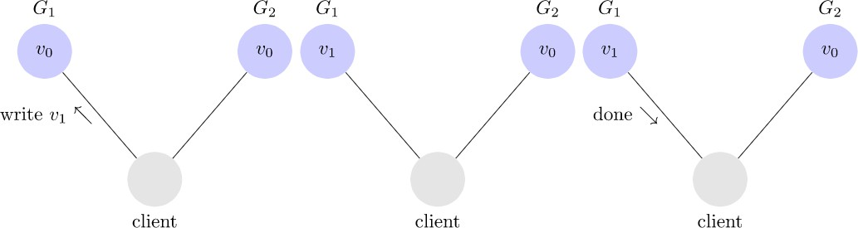
PROOF
Client writes to G₁
https://mwhittaker.github.io/blog/an_illustrated_proof_of_the_cap_theorem/

Slide 13
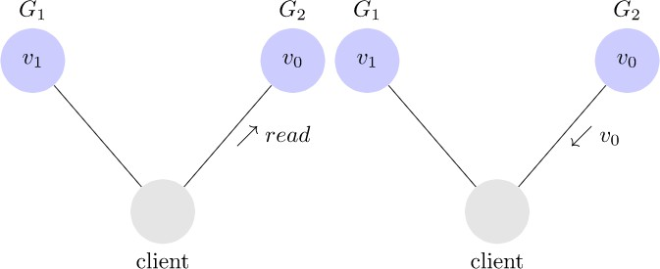
PROOF
Client reads from G₂
NOT CONSISTENT!
https://mwhittaker.github.io/blog/an_illustrated_proof_of_the_cap_theorem/

Slide 14
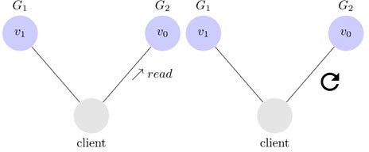
PROOF
Client reads from G₂
NOT AVAILABLE!
https://mwhittaker.github.io/blog/an_illustrated_proof_of_the_cap_theorem/

Slide 15
SYSTEM DESIGN
This suggests there are three kinds of distributed systems
CP
CA
AP
Why is it important?
Future of databases is distributed (Big Data Trend)
CAP theorem describes the trade-offs involved in distributed systems
Proper understanding of CAP theorem is essential to making decisions about distributed database/system design
Misunderstanding can lead to erroneous or inappropriate design choices

Slide 16
CONSISTENCY OR AVAILABILITY
Consistency & Availability is not “binary” decision
AP systems relax consistency in favor of availability – but are not inconsistent
CP systems sacrifice availability for consistency- but are not unavailable
This suggests both AP & CP systems can offer a degree of consistency, & availability, as well as partition tolerance

Slide 17
CONSISTENCY MODELS
Strong Consistency
After the update completes, any subsequent access will return the same updated value.
Weak Consistency
It is not guaranteed that subsequent accesses will return the updated value.
Eventual Consistency
Specific form of weak consistency
It is guaranteed that if no new updates are made to object, eventually all accesses will return the last updated value (e.g., propagate updates to replicas in a lazy fashion)

Slide 18

EVENTUAL CONSISTENCY – FACEBOOK EXAMPLE
Bob finds an interesting story and shares with Alice by posting on her Facebook wall
Bob asks Alice to check it out
Alice logs in her account, checks her Facebook wall but - Nothing is there!

Slide 19
EVENTUAL CONSISTENCY – FACEBOOK EXAMPLE
Bob tells Alice to wait a bit and check out later
Alice waits for a minute or so and checks back – Finds the wall post!

Slide 20
EVENTUAL CONSISTENCY – FACEBOOK EXAMPLE
Why would Facebook choose an eventual consistent model over the strong consistent one?
Facebook has billions of active users
It is non-trivial to efficiently and reliably store the huge amount of data generated at any given time
Eventual consistent model offers the option to reduce the load and improve availability

Slide 21
DYNAMIC TRADEOFF BETWEEN C AND A
An airline reservation system:
When most of seats are available: it is ok to rely on somewhat out-of-date data, availability is more critical
When the plane is close to be filled: it needs more accurate data to ensure the plane is not overbooked, consistency is more critical
Neither strong consistency nor guaranteed availability, but it may significantly increase the tolerance of network disruption

Slide 22
REFERENCES
Gilbert, Seth, and Nancy Lynch. "Perspectives on the CAP Theorem." Computer 45.2 (2012): 30-36
https://mwhittaker.github.io/blog/an_illustrated_proof_of_the_cap_theorem/
https://www.ibm.com/topics/cap-theorem#:~:text=The%20CAP%20theorem%20says%20that,'P'%20in%20CAP).

